Slide 1
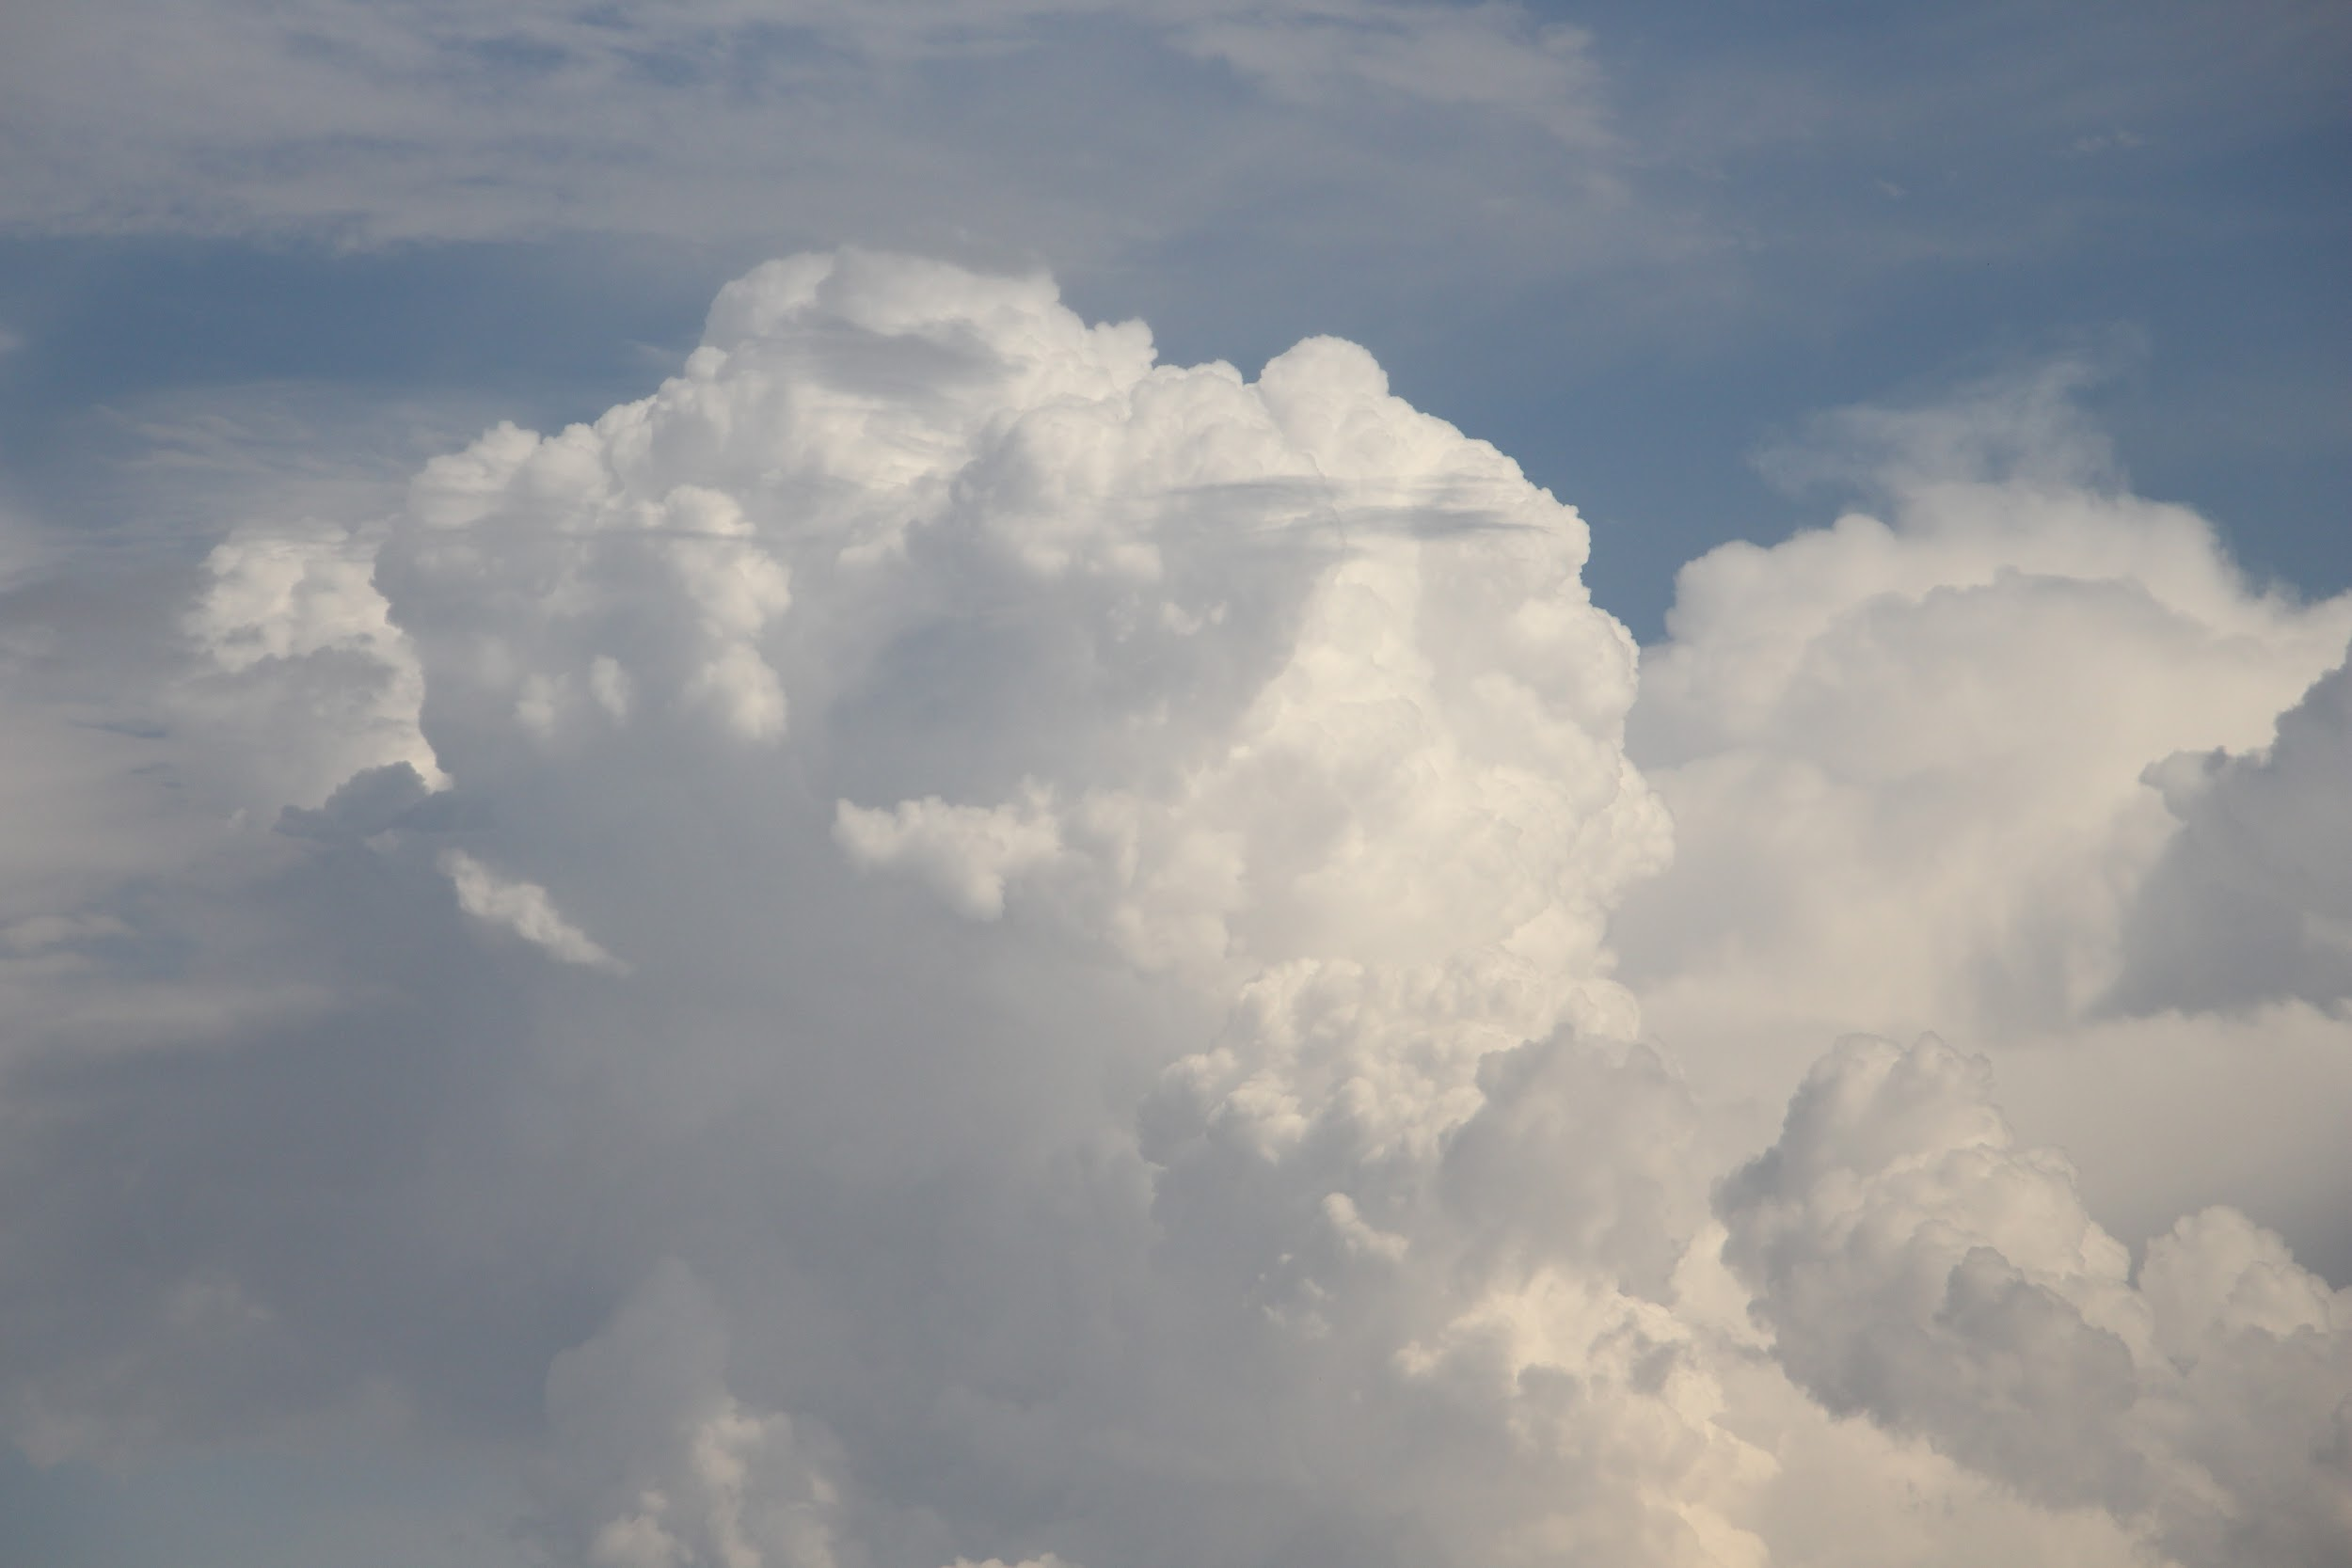
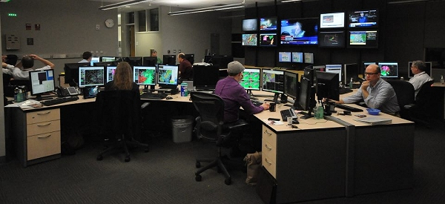
Now let’s put you to work!
Good morning! Its bright and early at 7 am and you’ve just shown up for your first shift of the week at the NWS Norman office!
You grab your preferred source of caffeine (Coffee Tea Dr. pepper) and get to forecasting!
Feel free to use the scratch paper and maps handed out to doodle or sketch notes.

Slide 2
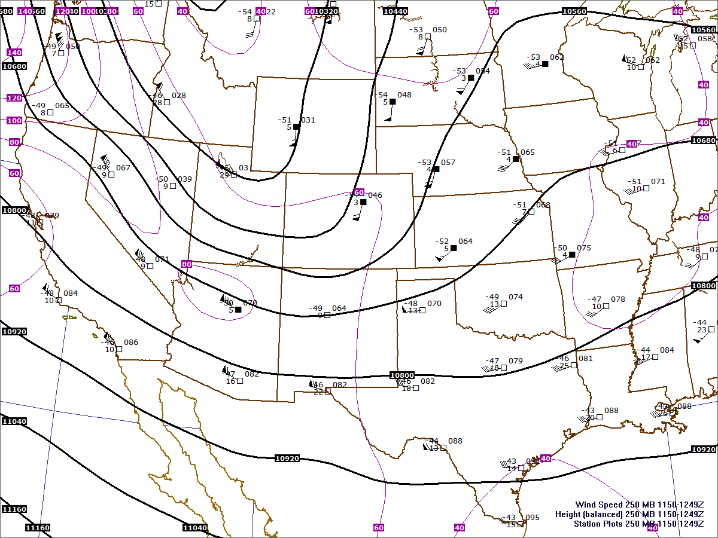
12z (6 am) 250 mb
35,000 ft
Trough of low pressure
Downstream Ridge of high pressure
Strong winds with a jet streak.

Slide 3
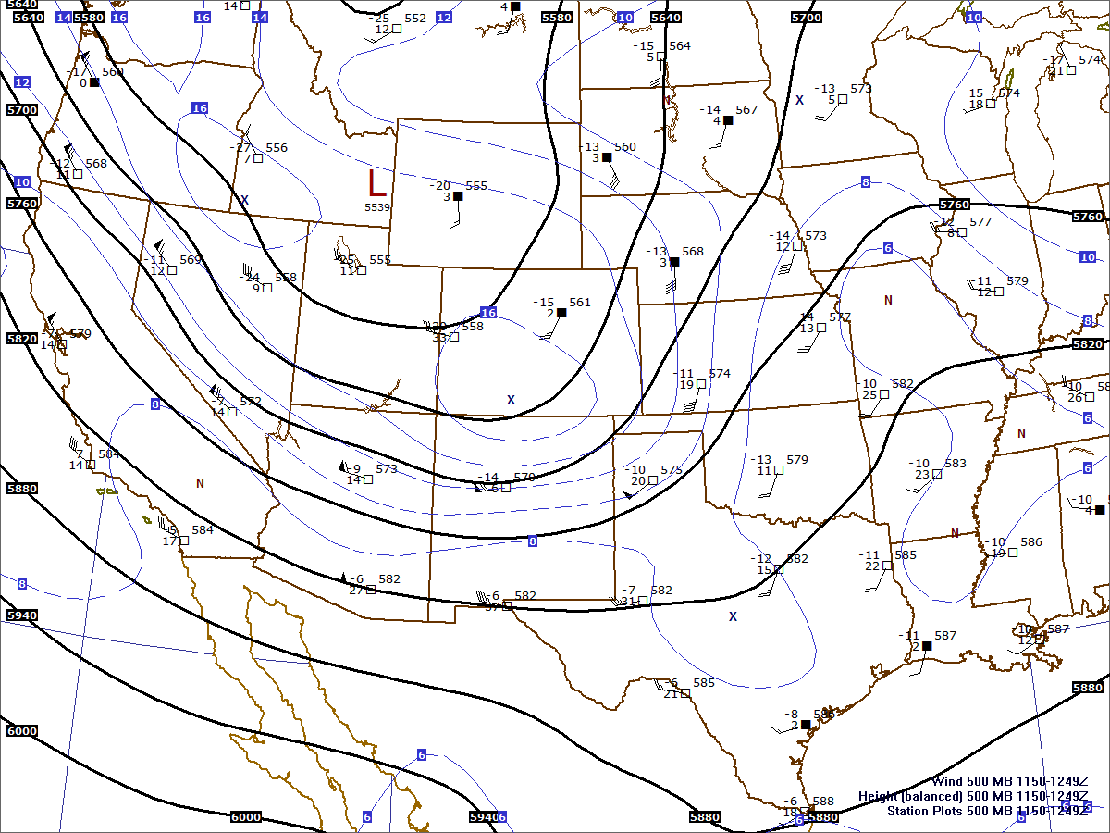
12z (6 am) 500 mb 20,000 ft
Trough of low pressure
Downstream Ridge of high pressure
Strong west and southwest winds with a jet streak.

Slide 4
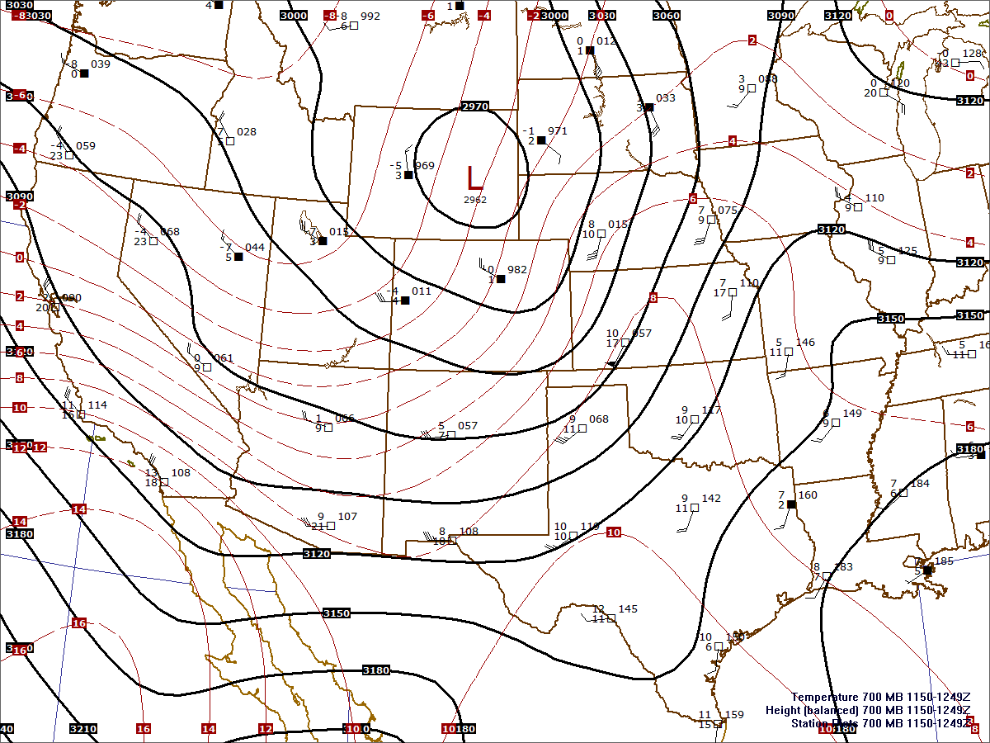
12z (6 am) 700 mb 10,000 ft
Area of low pressure
Warm air from the south
Strong southerly winds from a different direction.

Slide 5
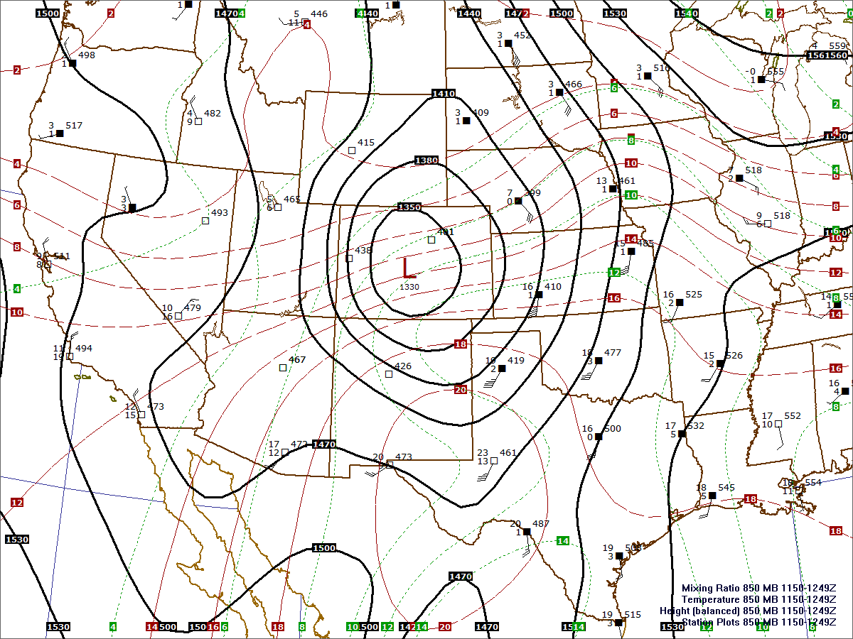
12z (6 am) 850 mb 5,000 ft
Area of low pressure
Warm and moist air from the south
Strong southerly winds from a different direction.
Frontal boundaries

Slide 6
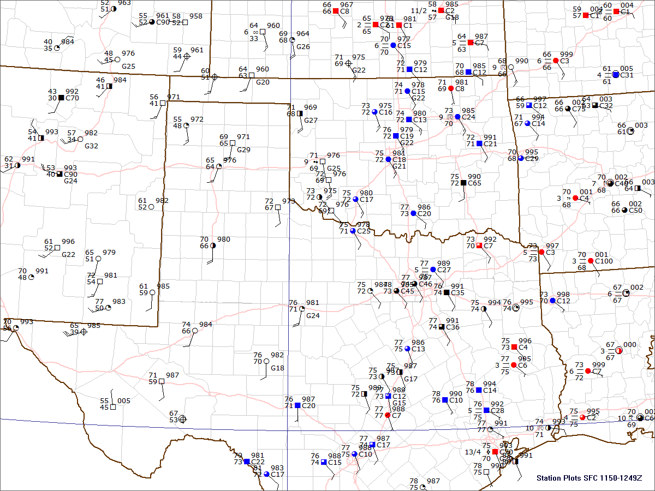
12z (6 am) Surface Chart
L
996 mb
Warm and moist air from the south
Strong winds from the Southeast
Frontal boundaries?
  Dryline
  Warm Front

Slide 7
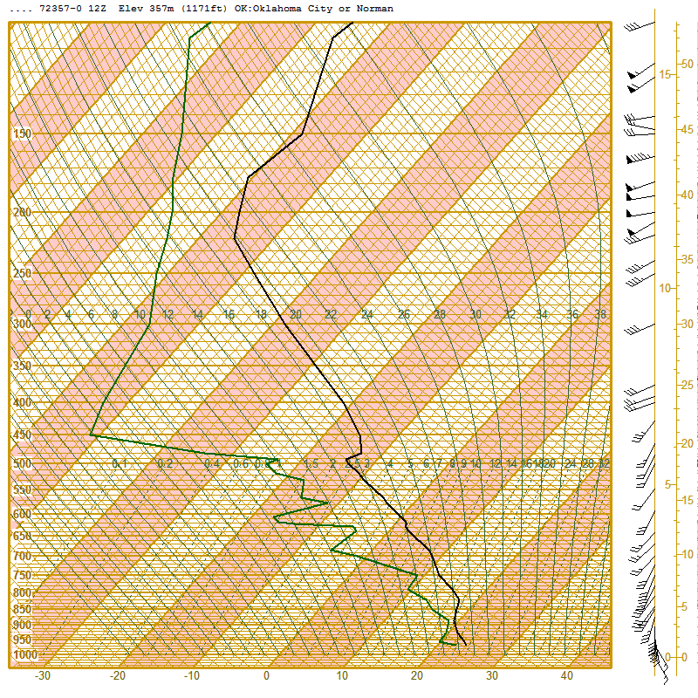
12z 6 am Sounding
Norman
Cool temps aloft but warm low-levels.
Lots of moisture! Surface dewpoint 22C (72F!)
Lifting our parcel generates positive and negative buoyancy (CAPE and CINH)
Winds changing direction and increasing in speed with height (wind shear)

Slide 8
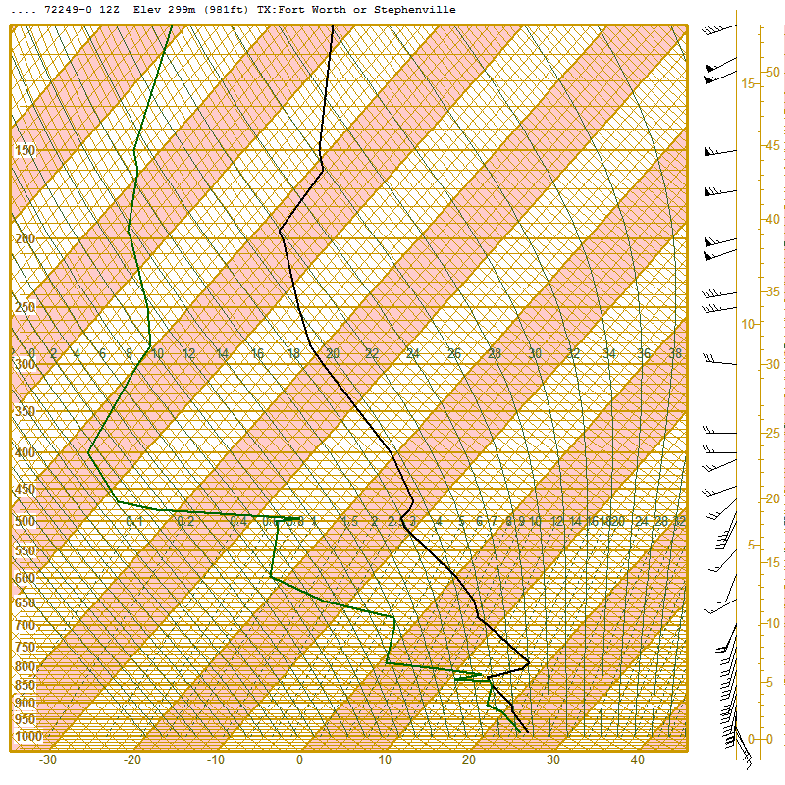
12z 6 am Sounding
Fort Worth, TX
Similarly cool mid-level temps
Warmer and more moist at the surface
Bigger CAPE? But also Bigger CINH?
Similar turning with height but weaker overall shear profiles.

Slide 9
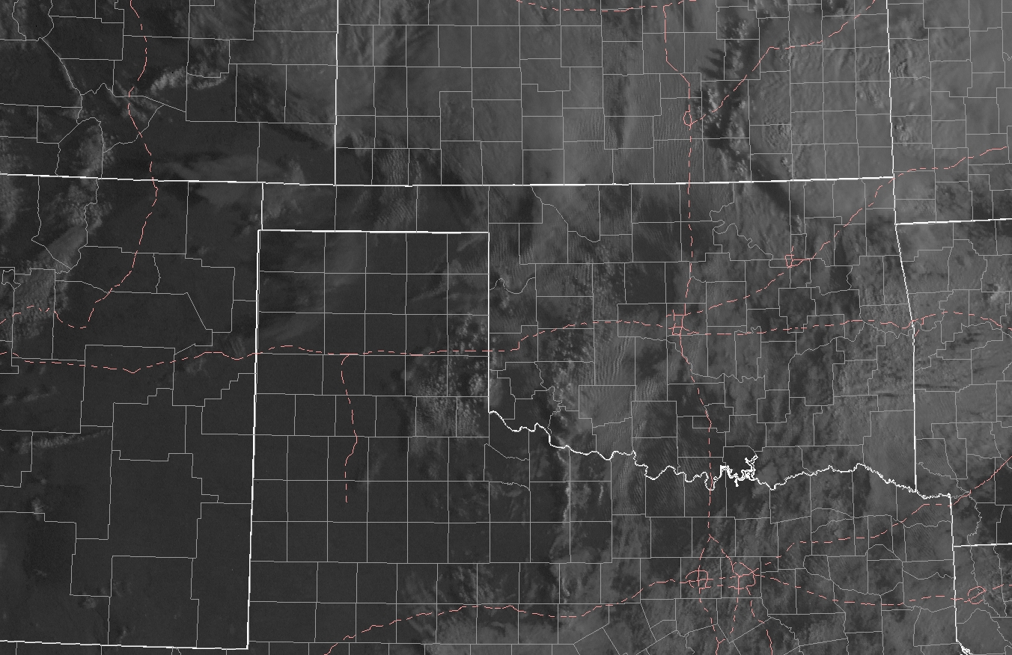
Satellite Imagery 1330z
☈

Slide 10
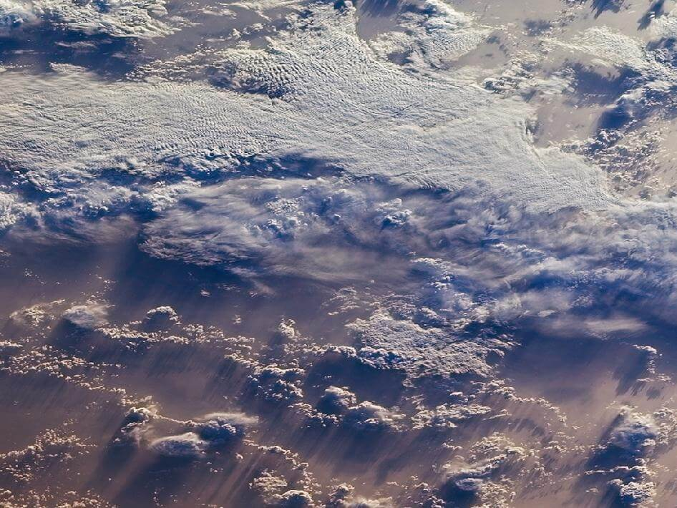
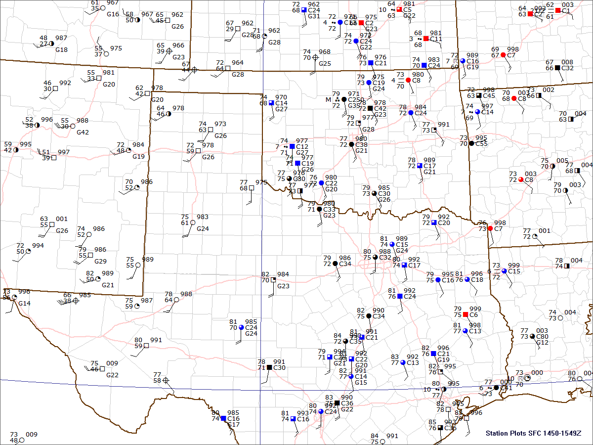
Surface 15z
What Changes do you notice?
Clearing across the TX Panhandle
Winds now due southwesterly
  What is the dryline doing?
Warming across south TX.
  How is the moisture?

Slide 11
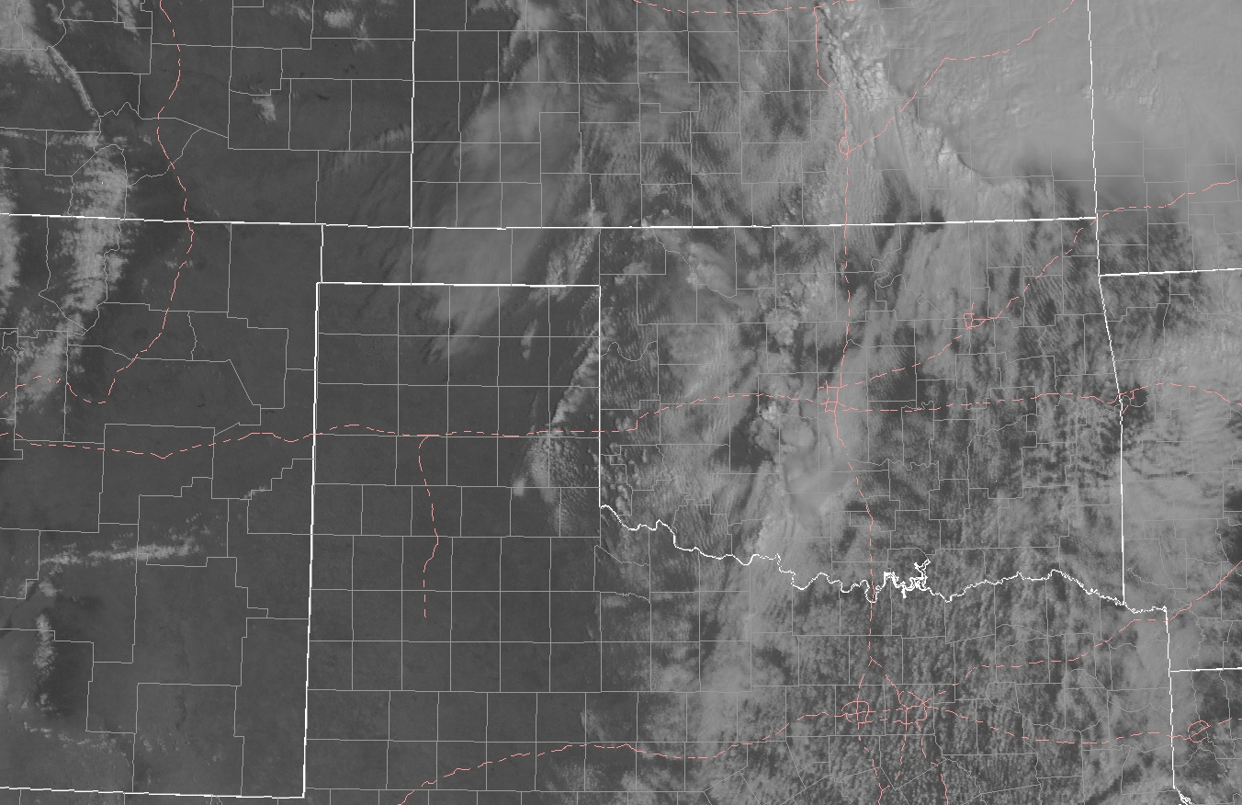
Satellite Imagery 1545z

Slide 12
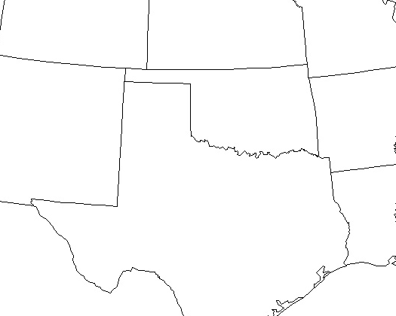
Time to make a forecast!
Do you think there is a risk for severe thunderstorms today?
  (What time of year is it?)
If you do think there is a risk for severe storms where do you think the highest risk is?
  Work with your group or yourself and try to highlight the risk area.
What storm mode and hazards?
  Outlook Category?
  Hail?
  Wind?
  Tornadoes?
??

Slide 13
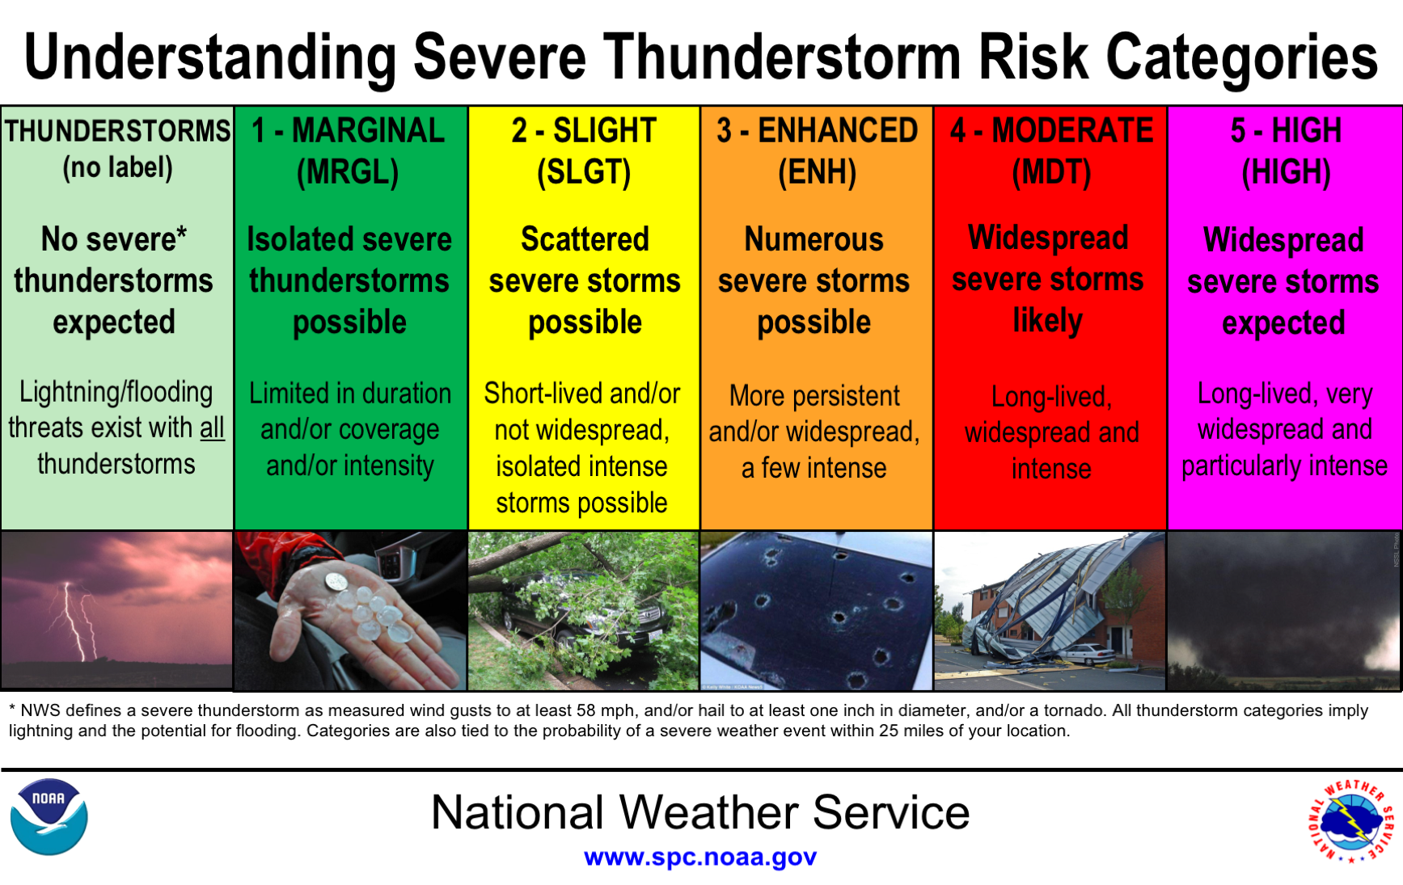

Slide 14
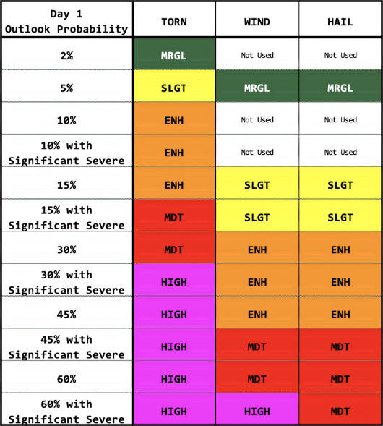
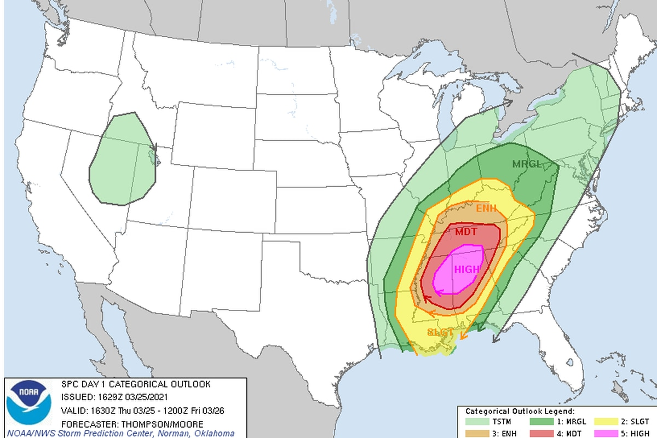
SPC Risk Categories & Probabilities
Each category has areal coverage probabilities of severe weather within 25 miles of a point.
You can use this guide to draw category labels and individual severe probabilities on your blank map.

Slide 15
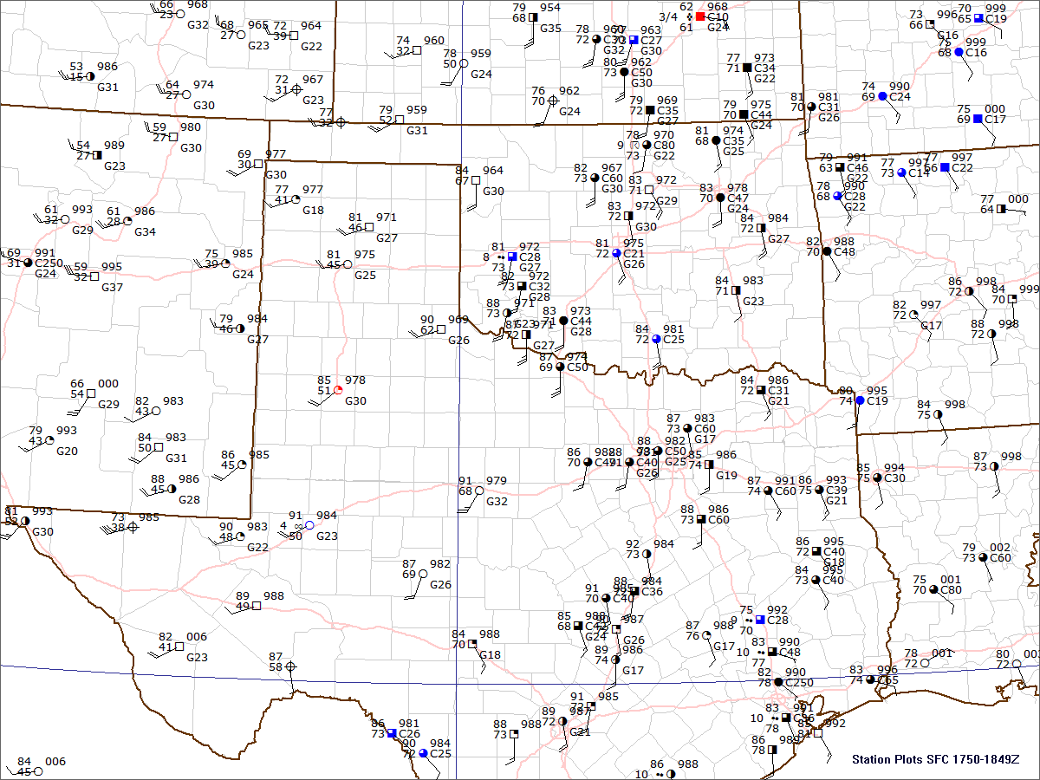
Surface 18z

Slide 16
Surface 18z
What Changes do you notice?
Clearing and warming across northwest Oklahoma.
How far east is the dryline?
What area might experience severe weather and what types?

Slide 17
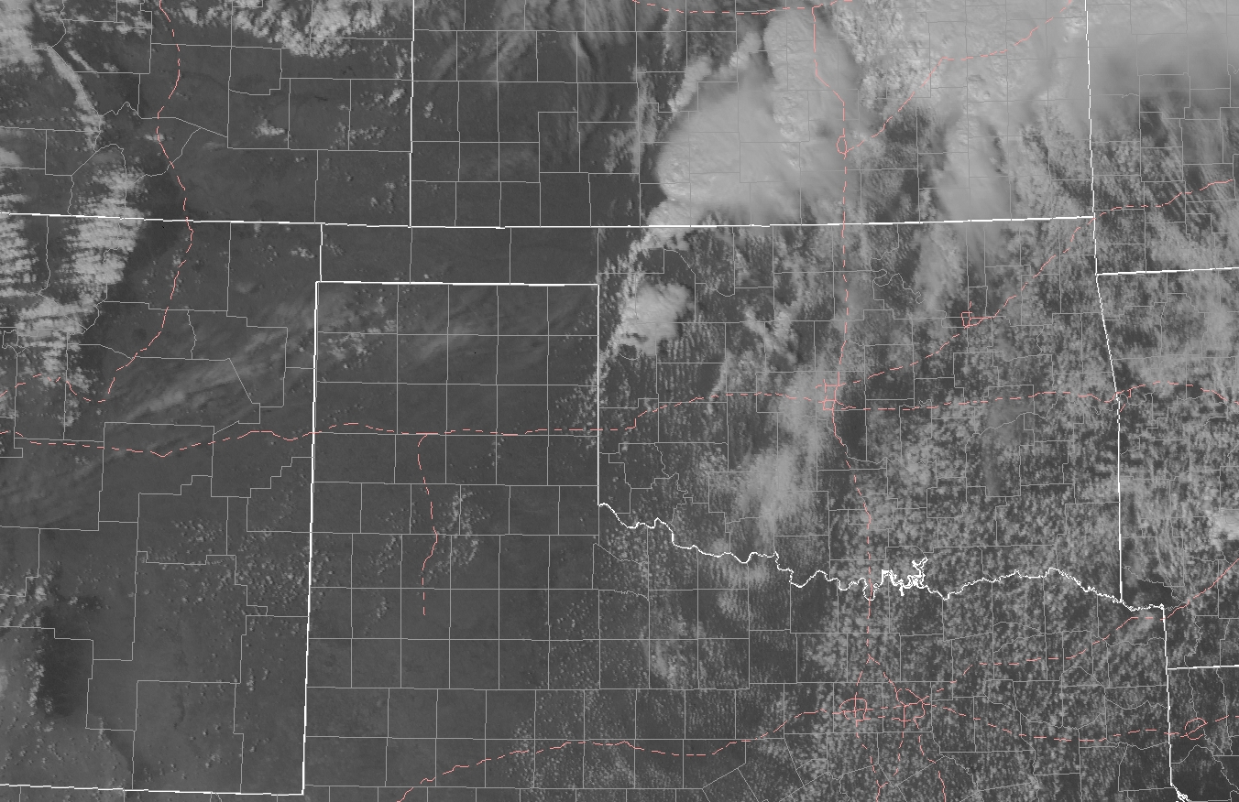
Satellite Imagery 1745z

Slide 18
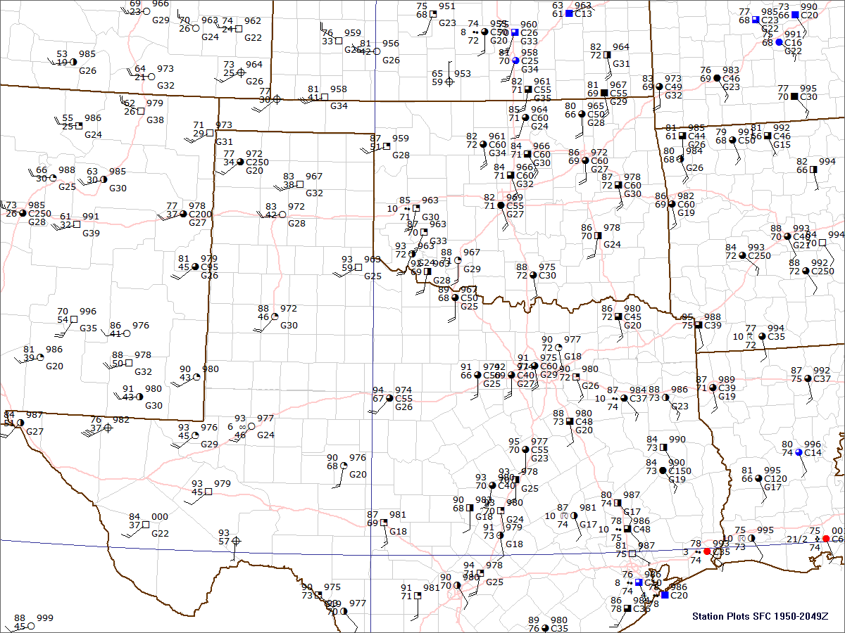
Surface 20z

Slide 19
Surface 20z
What Changes do you notice?
Clearing and warming across northwest Oklahoma.
How far east is the dryline?
What area might experience severe weather and what types?

Slide 20
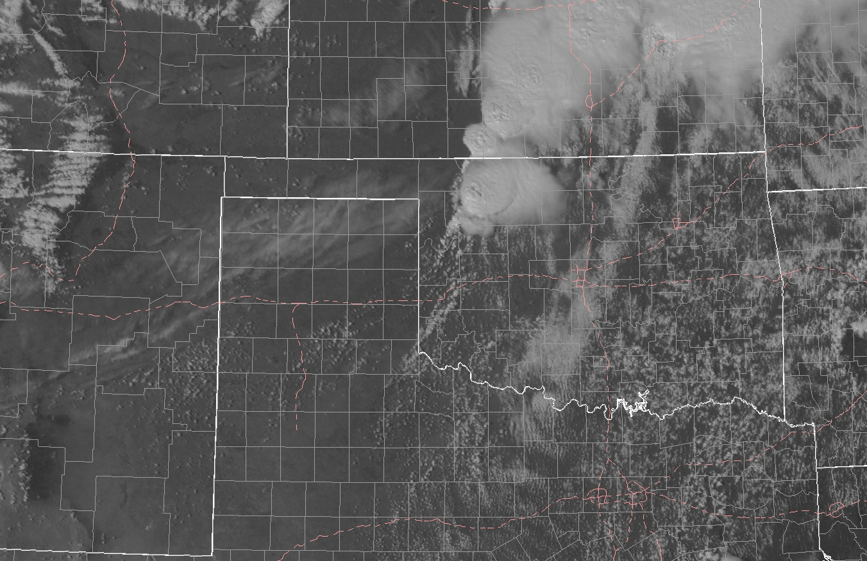
Satellite Imagery 1945z
H
H
H
T(1925z)

Slide 21
Outlook Update?
Do you want to change the category up or down?
How do you feel about your forecast?
What factors are affecting your reasoning?
Are there areas you are more concerned about than others?
??

Slide 22
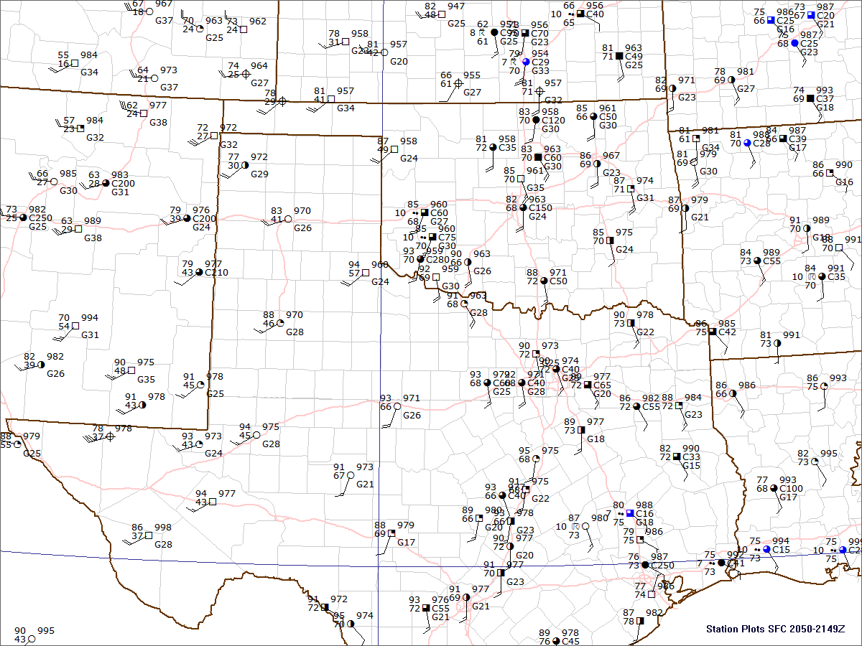
Surface 21z

Slide 23
Surface 21z
What Changes do you notice?
Clearing and warming across northwest Oklahoma.
How far east is the dryline?
What area might experience severe weather and what types?

Slide 24
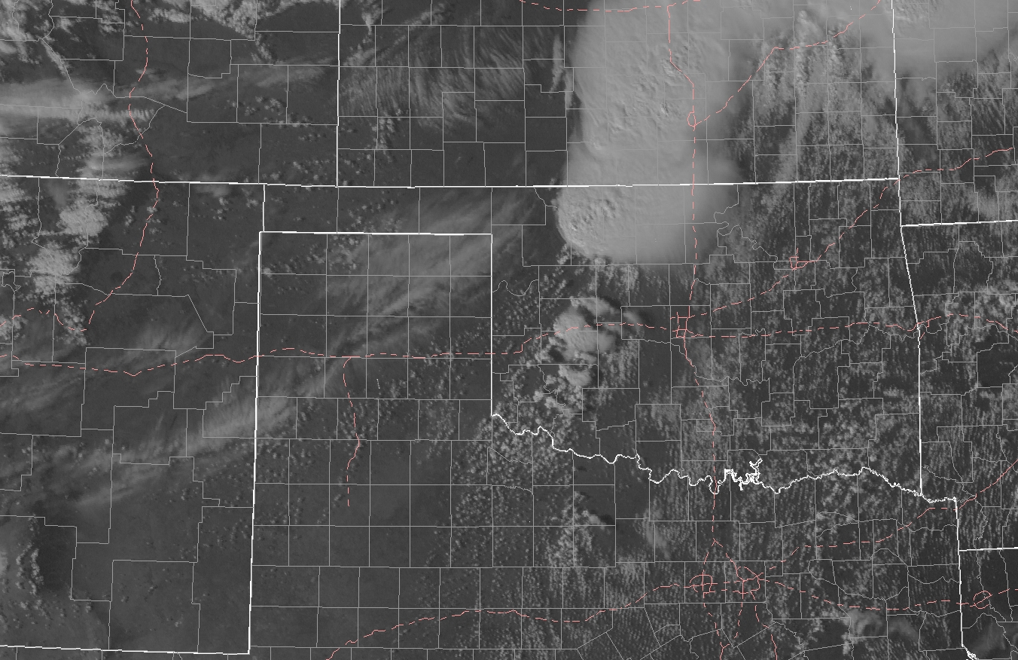
Satellite Imagery 2045z
H
H
T(2005z)

Slide 25
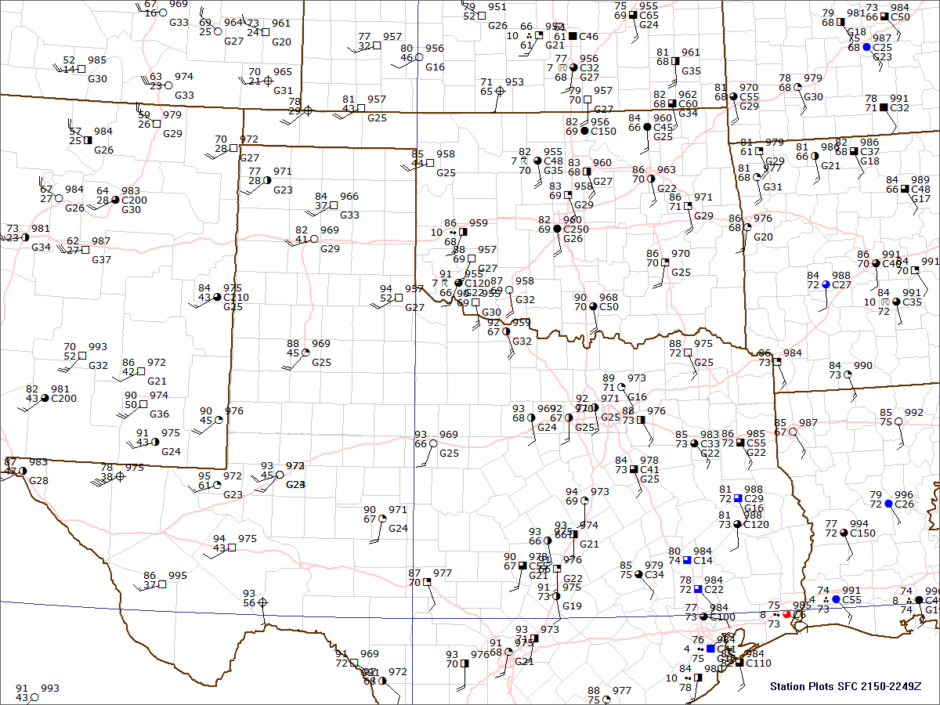
Surface 22z

Slide 26
Surface 22z
What Changes do you notice?
Clearing and warming across northwest Oklahoma.
How far east is the dryline?
What area might experience severe weather and what types?

Slide 27
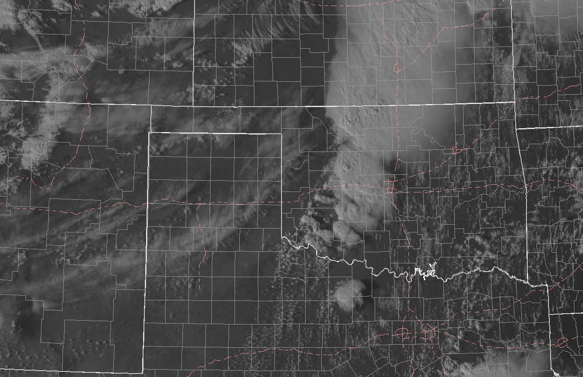
Satellite Imagery 2145z
T
T
T

Slide 28
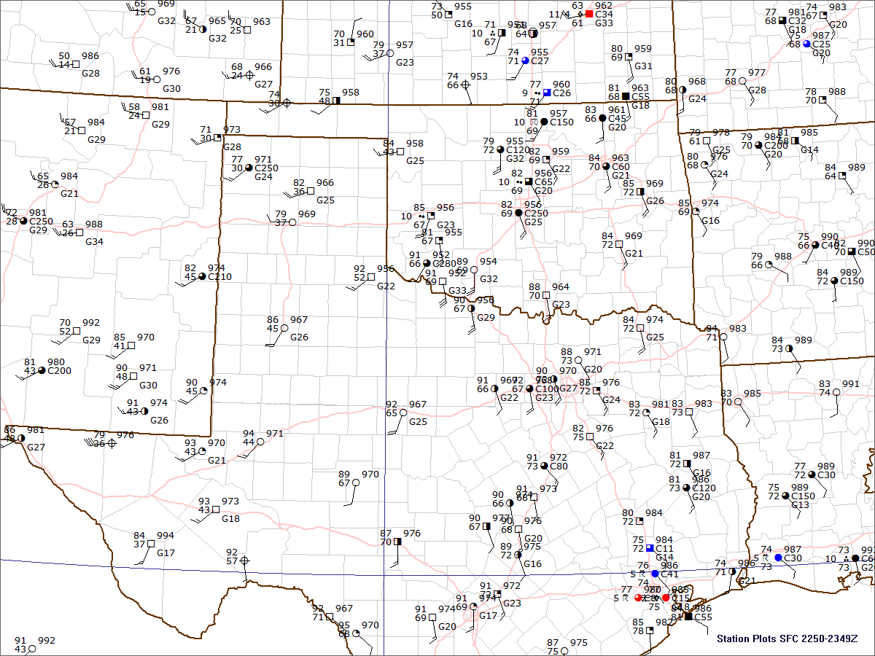
Surface 23z

Slide 29
Surface 23z
What Changes do you notice?
Backing (more southeasterly) and strengthening of the winds across central Oklahoma
Surface Pressure Falls

Slide 30
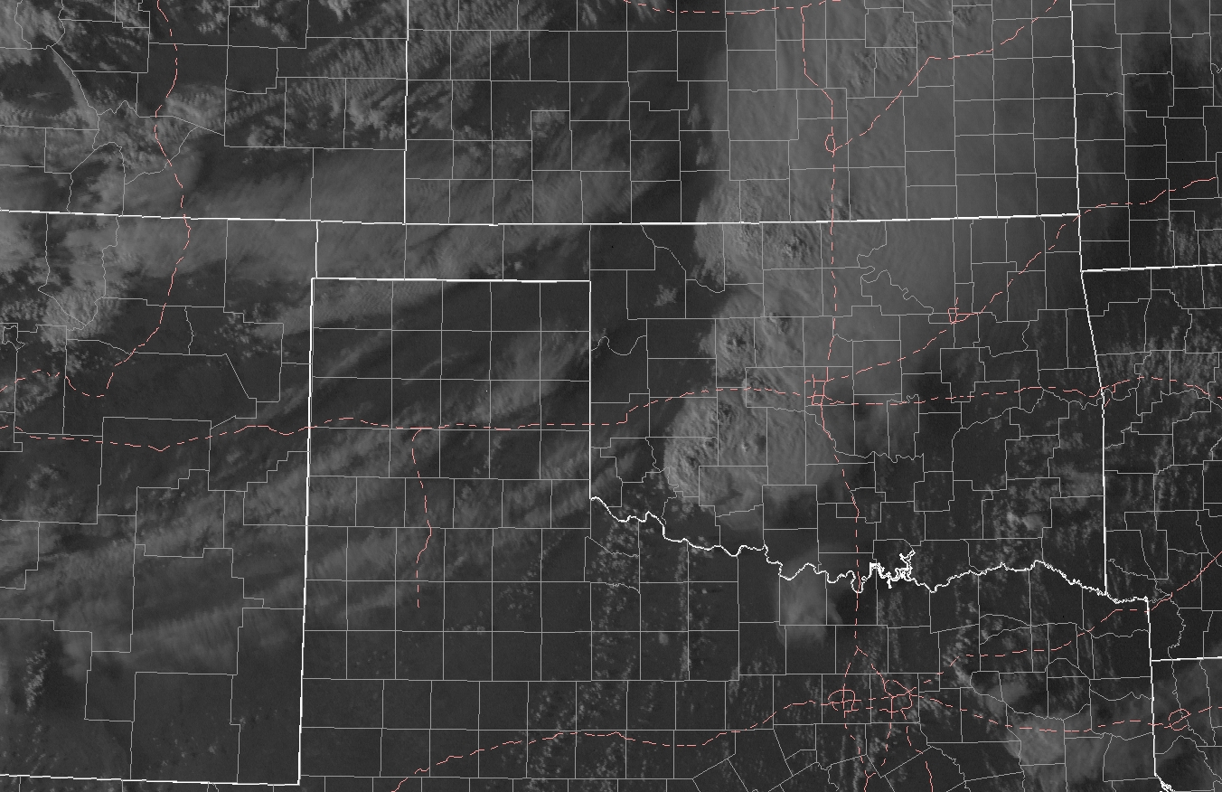
Satellite Imagery 2245z
Surface 23z
What Changes do you notice?
Clearing and warming across northwest Oklahoma.
How far east is the dryline?
What area might experience severe weather and what types?
T
T
T
T
T

Slide 31
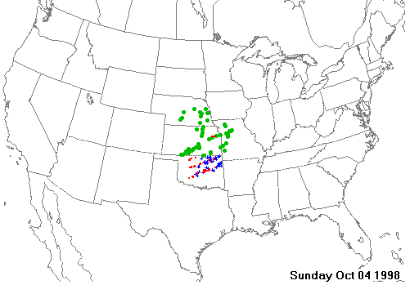
10/04/1998
Tornado Reports
Hail Reports
Wind Reports
Fall tornado outbreak across OK.
30 tornadoes mostly across central OK.
What were the big players?
Large western trough and strong lee low in CO.
Good moisture east of a Dryline and low-level shear across much of OK.

Slide 32
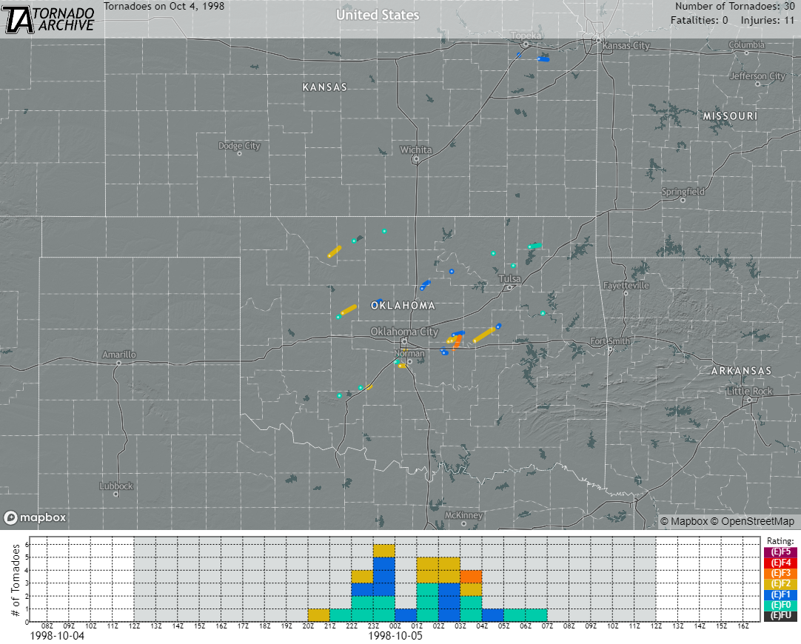
So What happened?
How did your forecast workout?
Were there any surprises?

Slide 33
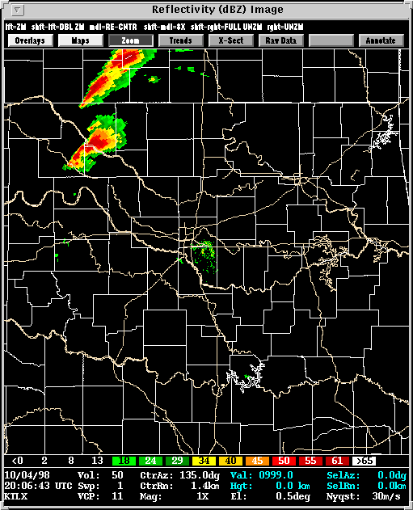
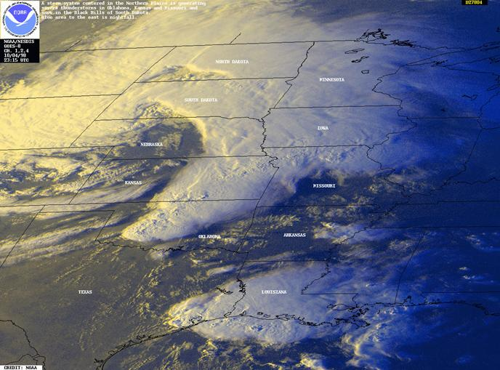
Radar and Satellite

Slide 34
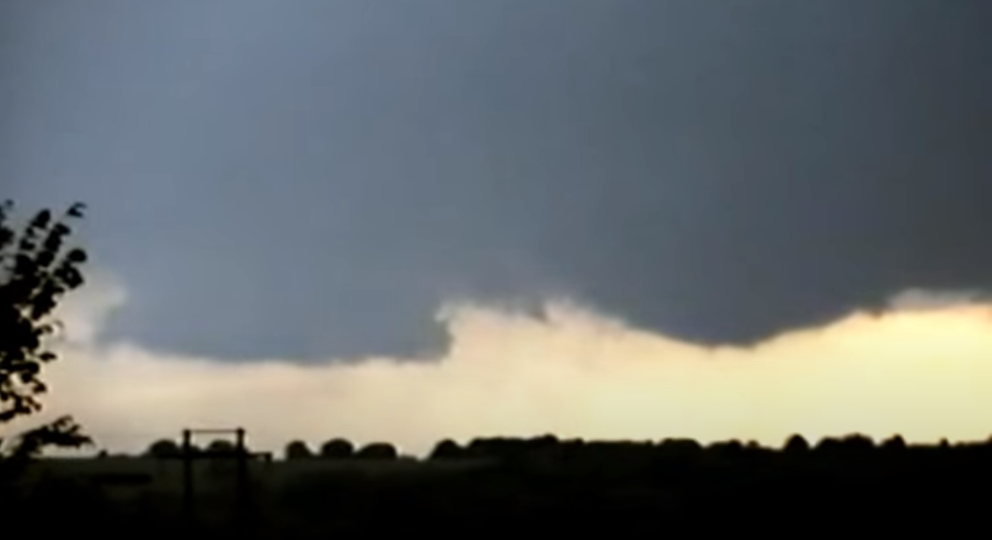
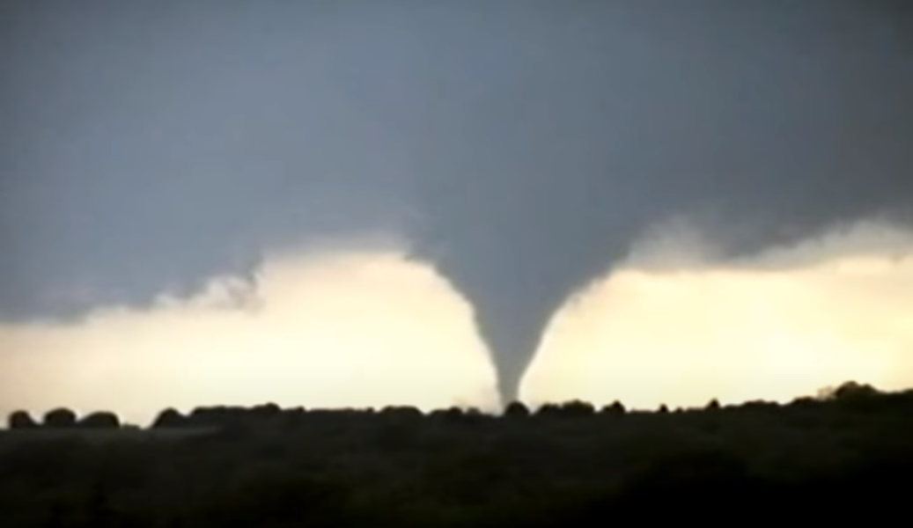
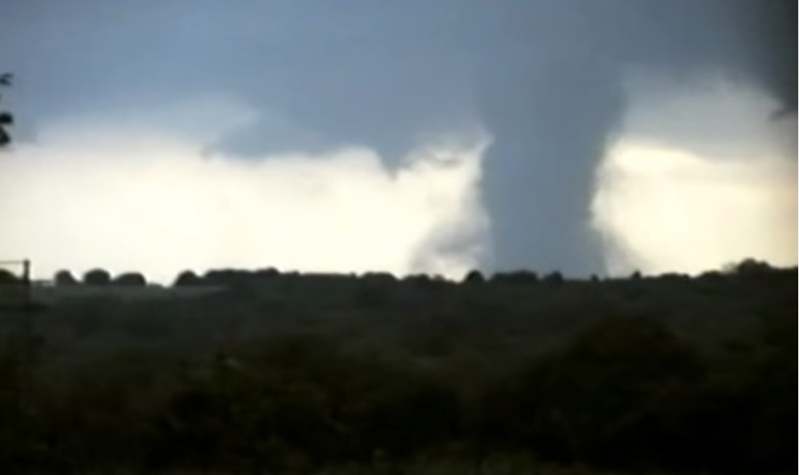
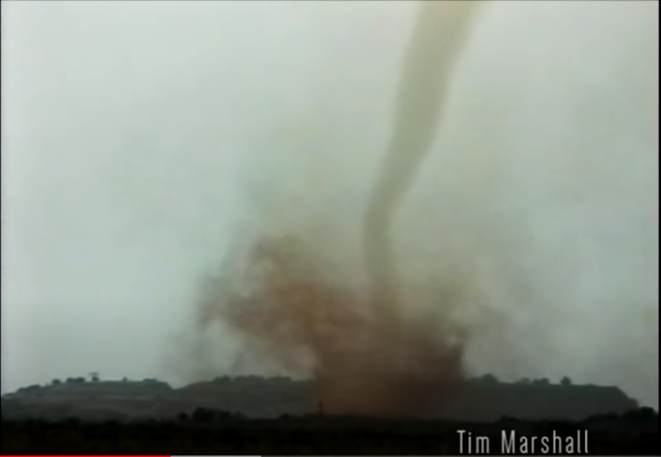
10/04/1998
Evolution over ~2 minutes
Fall tornado outbreak across OK.
30 tornadoes mostly across central OK.
What were the big players?
Large western trough and strong lee low in CO.
Good moisture east of a Dryline and low-level shear across much of OK.
~6:45 PM Stillwater, OK EF-1
Watonga, OK Tornado

Slide 35
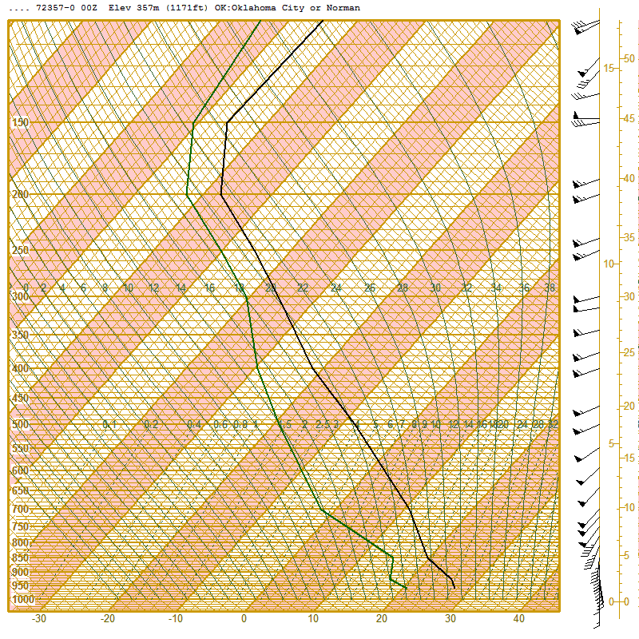
00z 6pm Sounding
Norman
Cool mid-level temps but warm low-levels.
Lots of moisture! Surface dewpoint 21C (70F!)
2000+ J/kg of MLCAPE plenty for strong updrafts
Strong turning and shear in the low-levels with a 40-55 kt low-level jet. Did you plot a hodograph?
Favorable deep-layer shear for supercells

